Slide 1

Sensor Kit (Kit 1)
ZAS Robotics Training

Slide 2



Sensor Kit - Contents
Sensor Kit Components
Sensor Creative Board

Slide 3



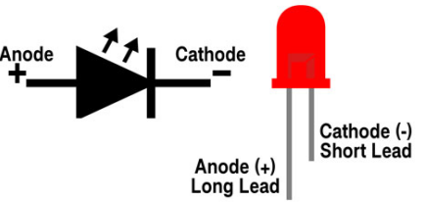

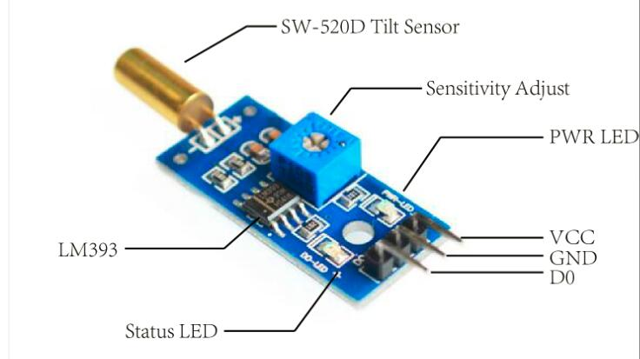
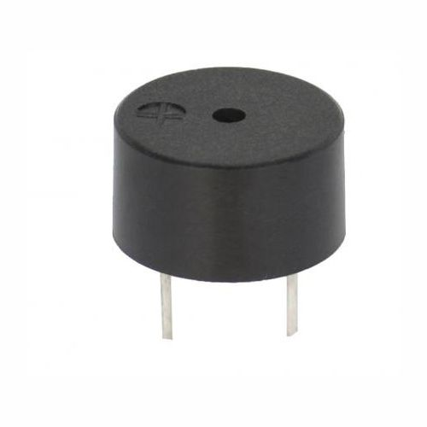
SFL09: TILT SENSOR WITH LED AND BUZZER
Things Needed

Slide 4
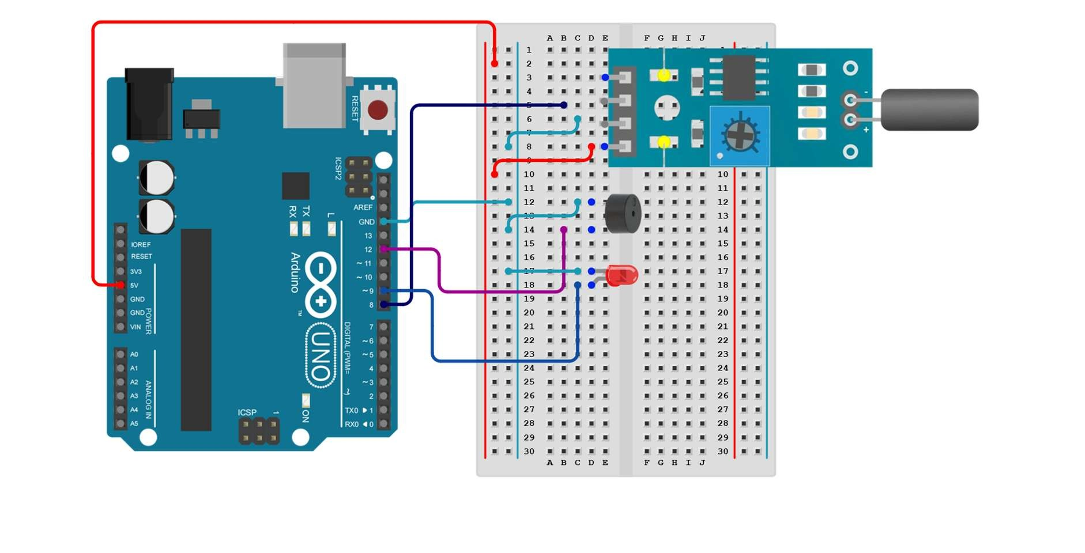
SFL09: TILT SENSOR WITH LED AND BUZZER
Connections:
Arduino pins | Breadboard (tilt sensor)
GND | GND(LIGHT BLUE)
5V | VCC(red)
Pin 8 | Digital output(dark blue)

Slide 5
SFL09: TILT SENSOR WITH LED AND BUZZER
Define library and module pins
Setup()
VCC and GND of the tilt sensor and digital output to pin8
buzzer pin to 12
led pin to 8
Loop()
read the state if tilt sensor
If it is activated, then turn on the LED and buzzer
else turn off the LED and buzzer.
Code for Lesson SFL09:
https://github.com/info-zas/zas-robotics-sensors/blob/main/01_FoundationProjects/01_Code/_09_DisplayingTextAndDataOnAnOLED/_09_DisplayingTextAndDataOnAnOLED.ino

Slide 6
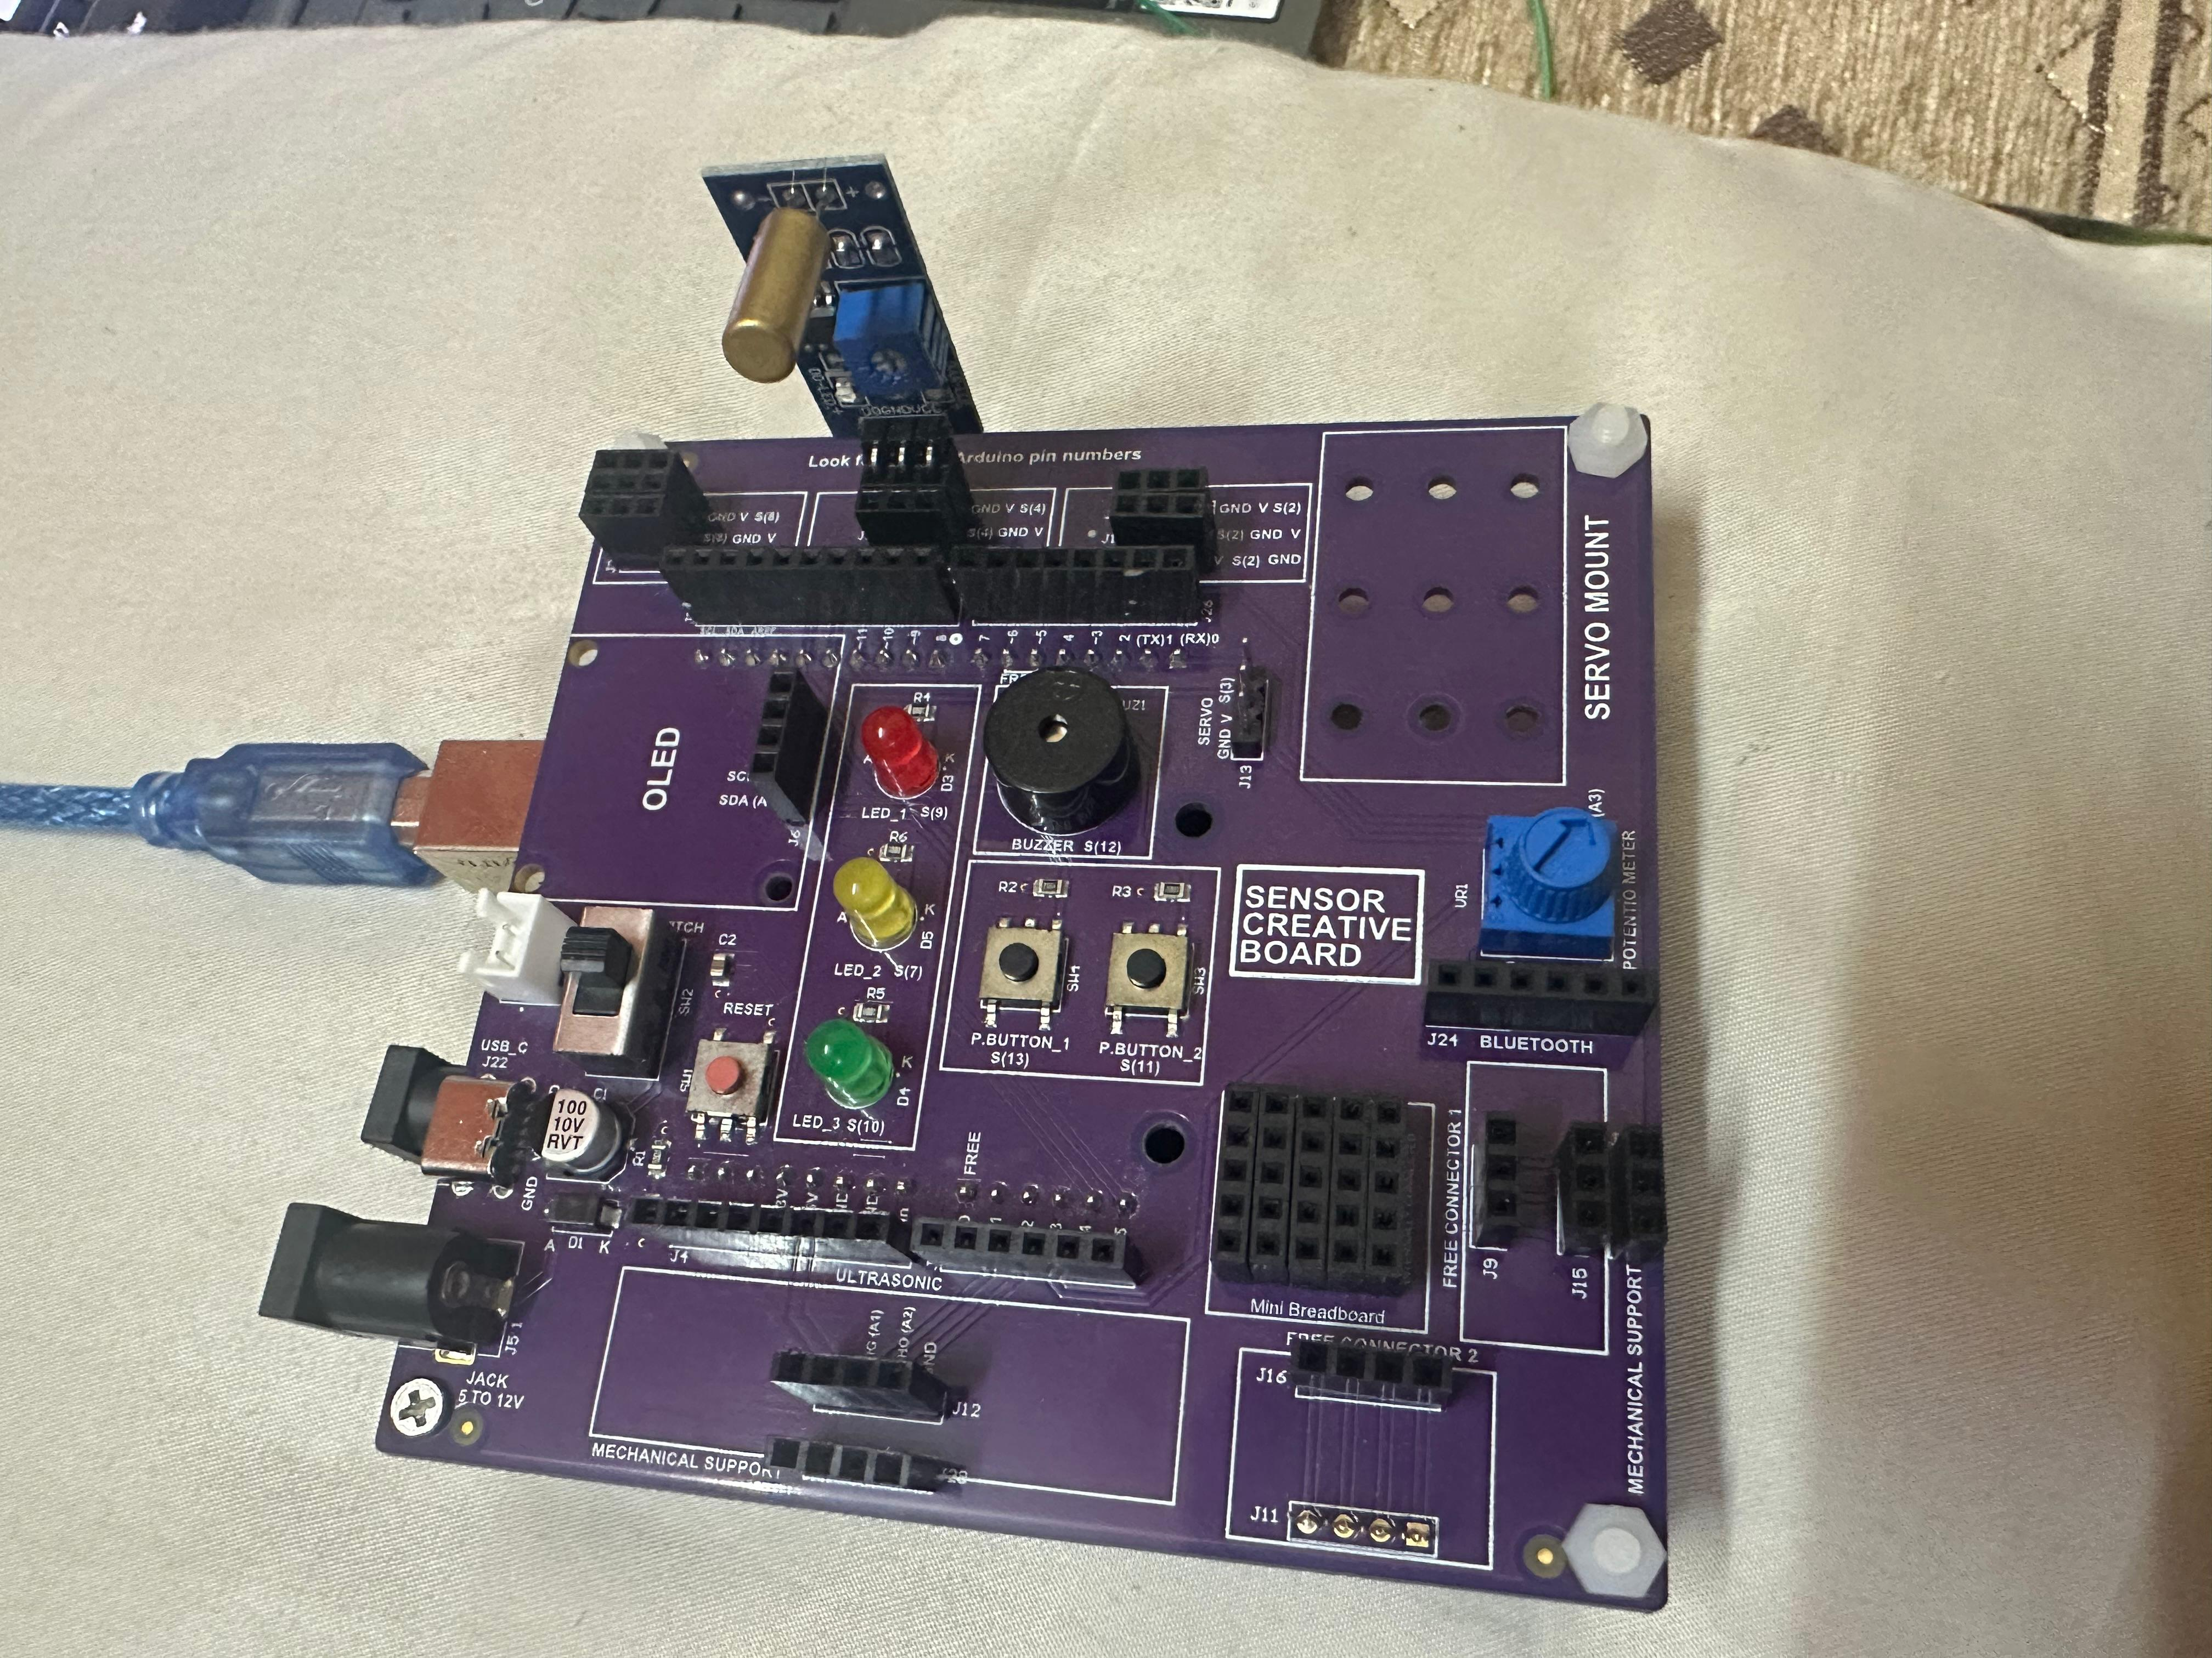
SFL09: TILT SENSOR WITH LED AND BUZZER

